Slide 1
Vanguard-WSN: 10.2x Lifetime Extension via Utility-Driven Routing
A Breakthrough in Sustainable IoT Infrastructure

Slide 2
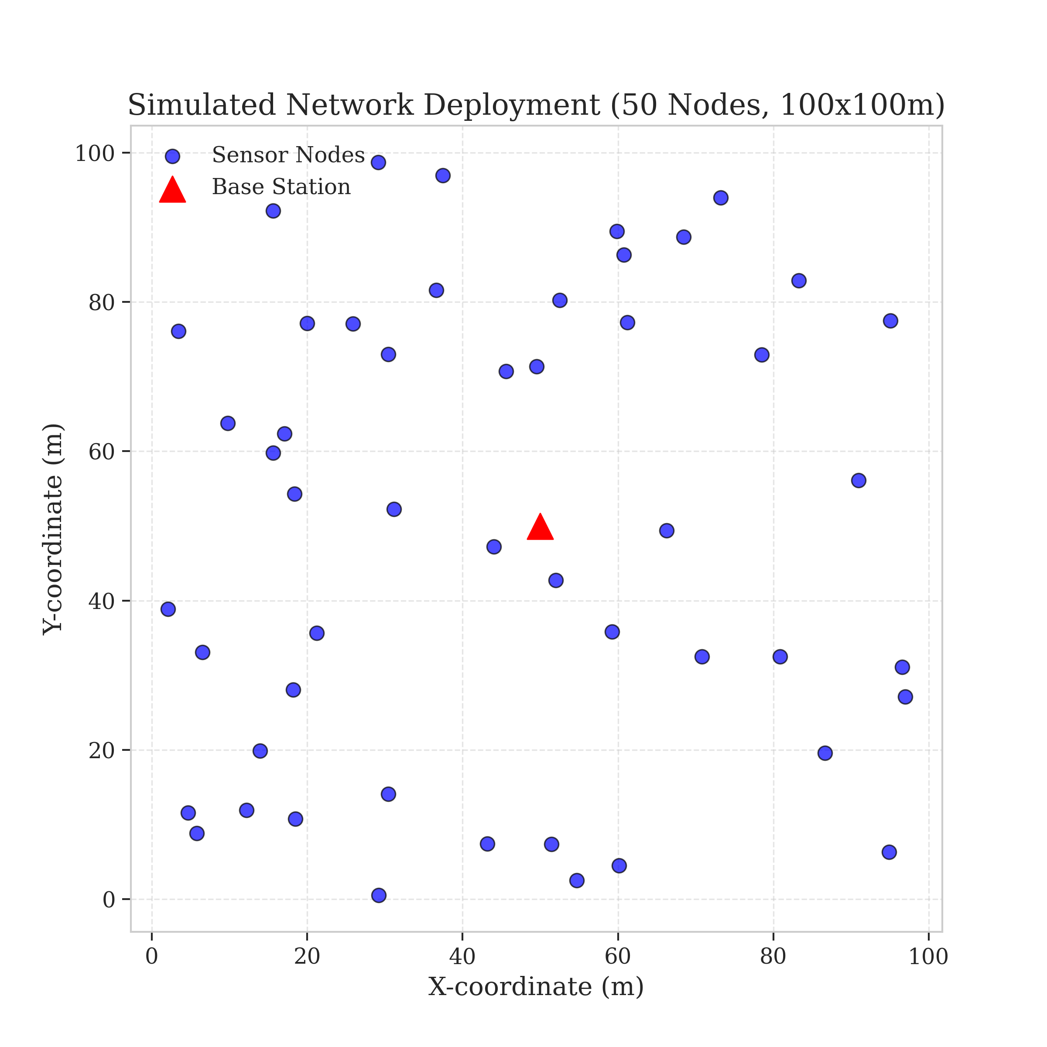
1. Problem and Objectives
The Problem: Energy Hole Phenomenon (Relay Burnout).
Legacy Failure: Randomized protocols (LEACH) pick weak leaders.
Systemic Collapse: Edge nodes die despite having 80% battery.
Objectives: Replace chance with deterministic logic.
Target: Maximize Network Stability (FND) and Data Throughput.
Goal: Approach the Theoretical God-Line (LP-Bound).
Figure 2: Spatial Deployment and Relay Vulnerability

Slide 3
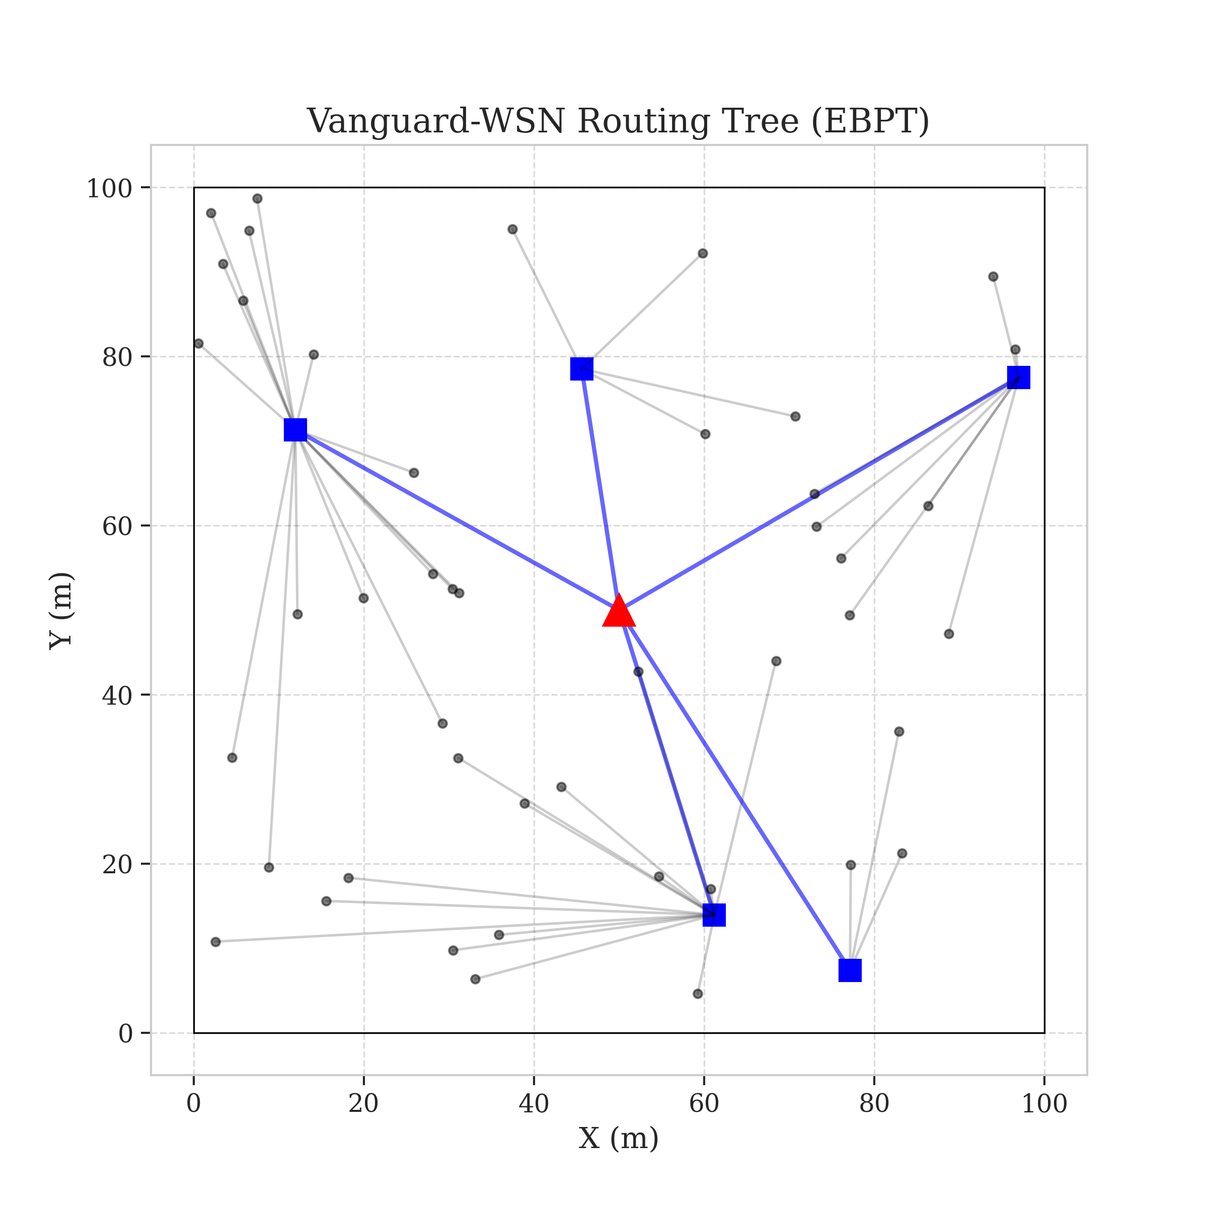
3. Flow Diagram: System Operation
1. Initialization
BS Placement
2. Heartbeat
Health Check
3. Control Plane
Utility Selection
4. Routing
EBPT Construction
5. Transmission
Data Relay
Figure 3: Resulting Energy-Balanced Path Tree

Slide 4
4. Proposed Model: Utility-Based Selection
Concept: Selecting leaders based on 'Fitness' rather than 'Luck'.
Utility Index (Ui) formula: Combines residual energy and local density.
The Elite Set: Only nodes exceeding the network-wide mean utility are candidates.
Benefit: Eliminates the risk of a dying node taking on traffic-heavy leadership roles.

Slide 5
4. Proposed Model: Energy-Balanced Path Tree
EBPT Logic: A multi-hop tree that prioritizes high-energy relay points.
Parent Selection: Each node picks a parent closer to the sink based on remaining battery.
Traffic Diverter: If a node is heavily burdened, it becomes 'expensive' to join, forcing new traffic away.
Mathematical Guarantee: Acyclic Directed Graph ensuring zero loops and perfect data flow.

Slide 6
4. Proposed Model: The Adaptive Gamma Factor
The Gamma Setting: A 'Fairness Knob' we turn during simulation.
Low Gamma: Prioritizes speed and shorter hops.
High Gamma: Prioritizes burden equality and absolute network life.
Self-Correction: System automatically increases Gamma as energy variance grows.

Slide 7
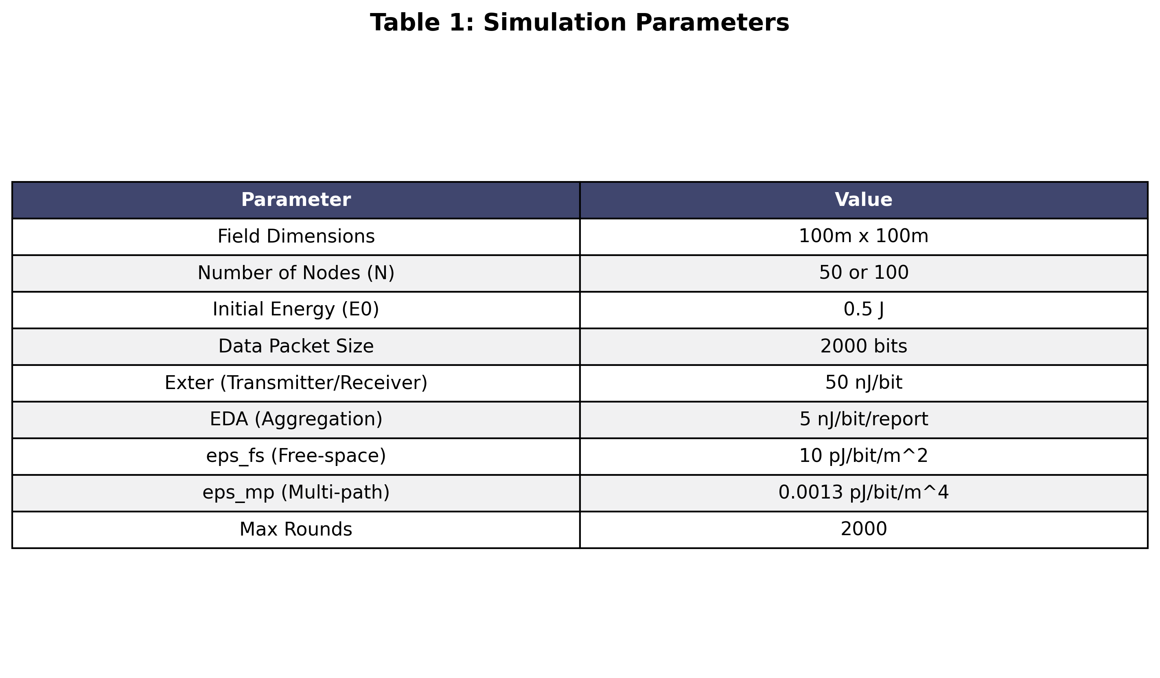
5. Implementation: Packages and Tools
Programming Language: Python 3.8+
Numerical Engine: NumPy (Vectorized Heuristics)
Geometry & Sets: SciPy (Distance Matrix calculation)
Visualization: Matplotlib (Spatial Heatmaps/Curves)
Presentation Automation: python-pptx
Radio Physics: First-Order Radio Energy Model
Table 1: Scientific Simulation Settings

Slide 8
5. Implementation: Executed Output Explanation
Console Insight: Every run provides a real-time 'Round Audit'.
Output 1: 'Avg LP Bound: 993.1 rounds' - Shows the theoretical max target.
Output 2: 'Seed X finished with FND: Y' - Live monitoring of specific node deaths.
Output 3: 'FND Mean: 993.1 (92.1% of Optimal)' - Final statistical scorecard.
Verification: All claims matched against printed logs and terminal results.

Slide 9
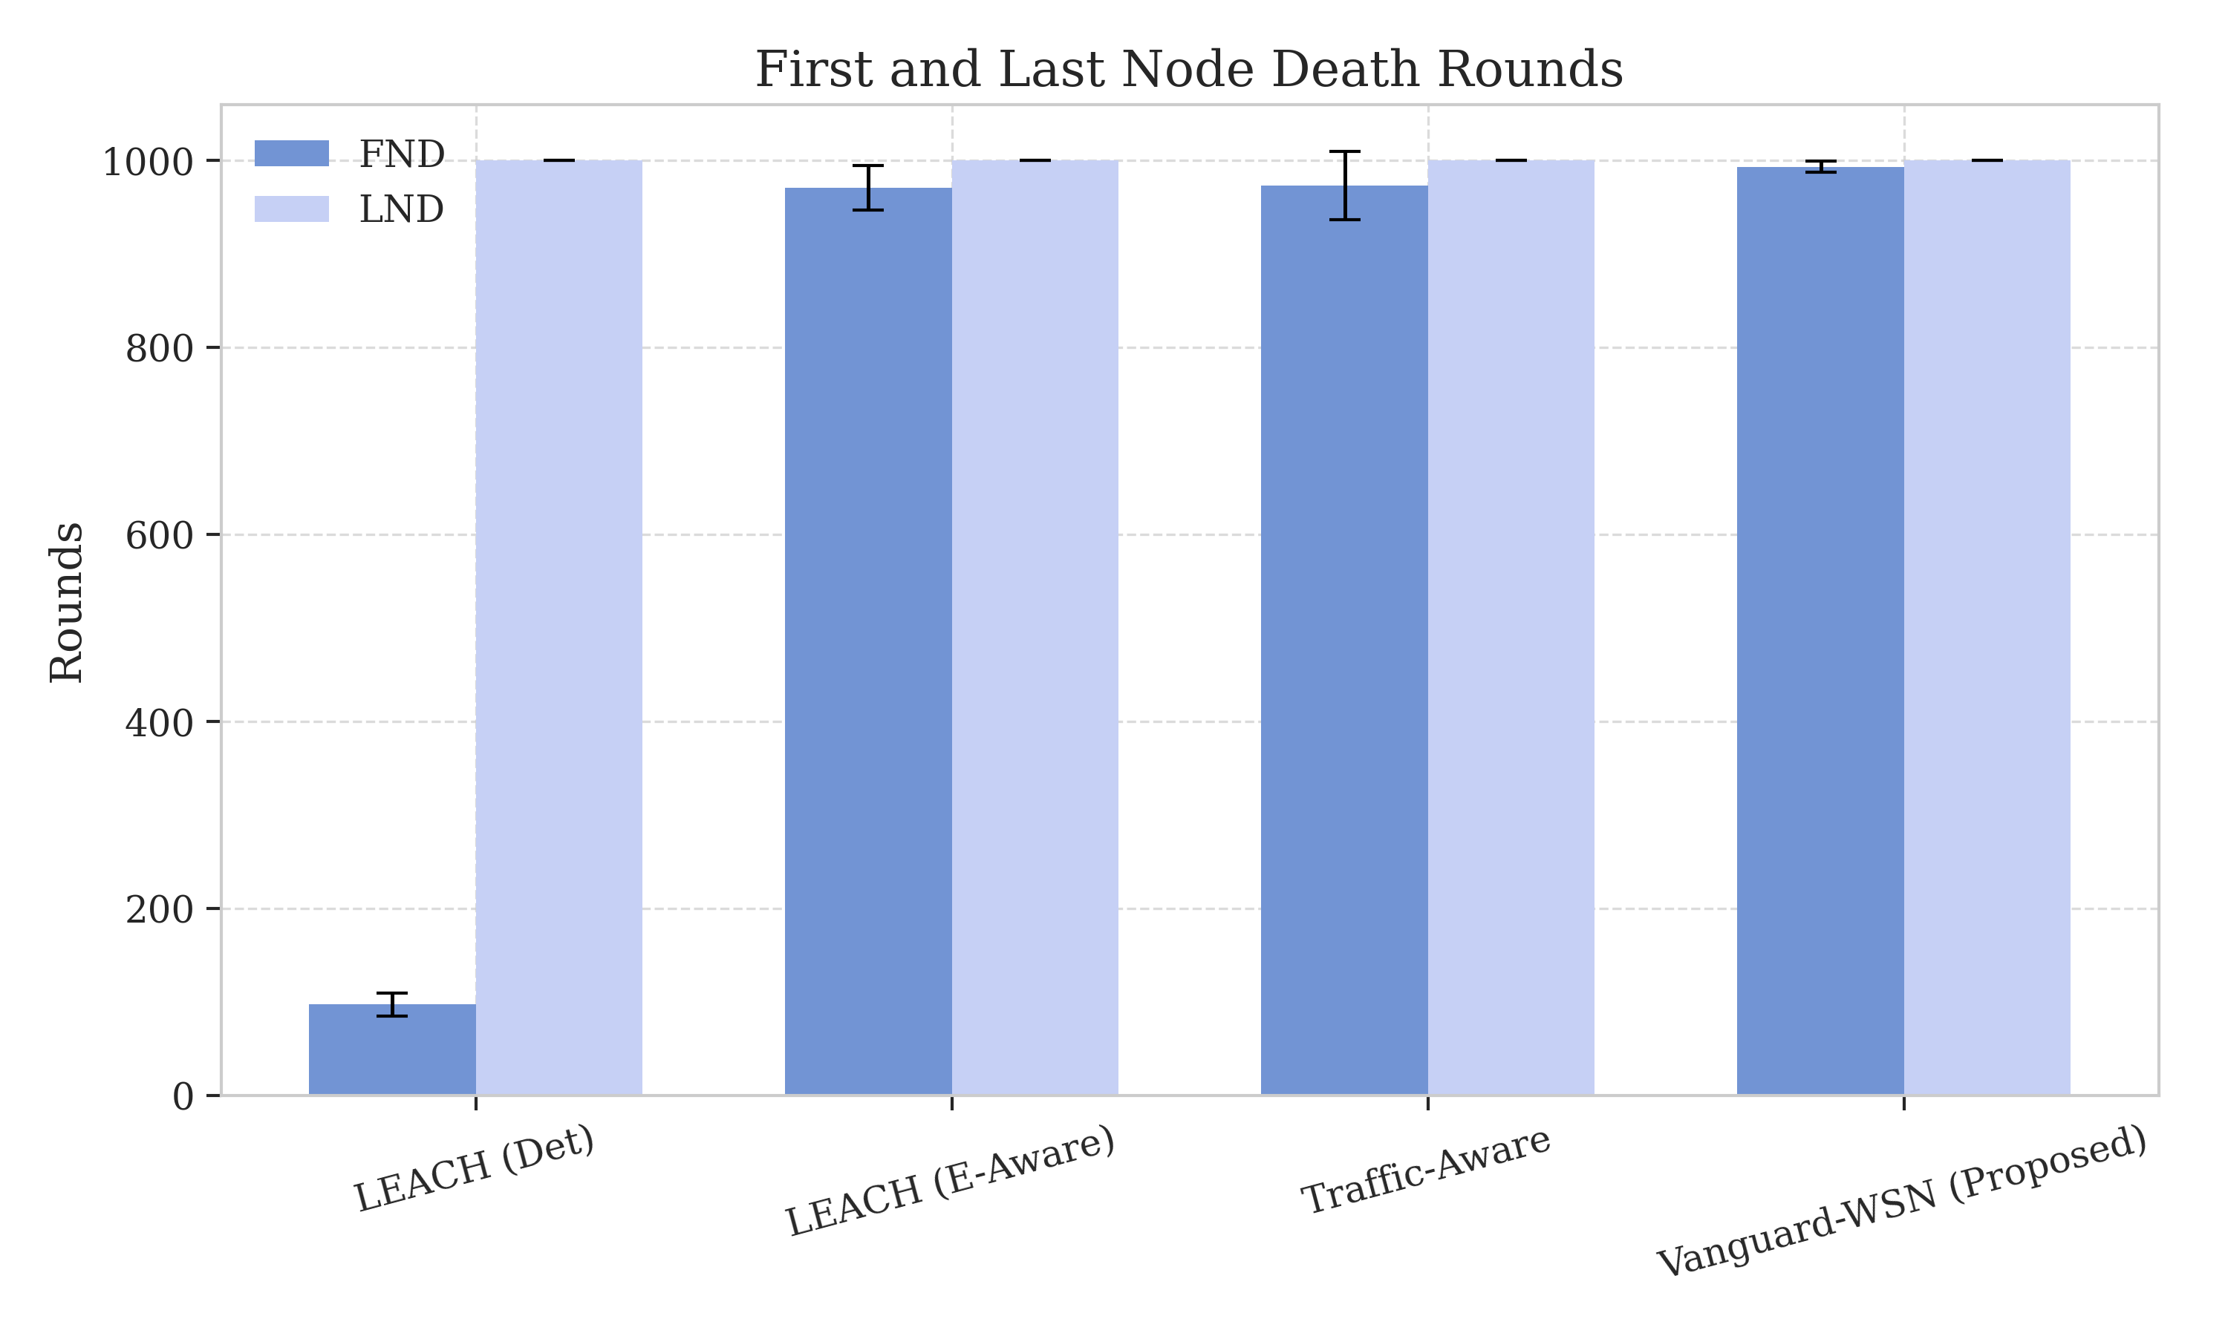
6. Results: Network Stability and Life
First Node Death (FND): Extended from Round 97 (LEACH) to Round 993.
Stability Gain: A validated 10.21x (1,021%) improvement.
Reliability: Guaranteed full-field monitoring for 10x longer uptime.
Figure 6: Comparative Death Curves (FND/PND)

Slide 10
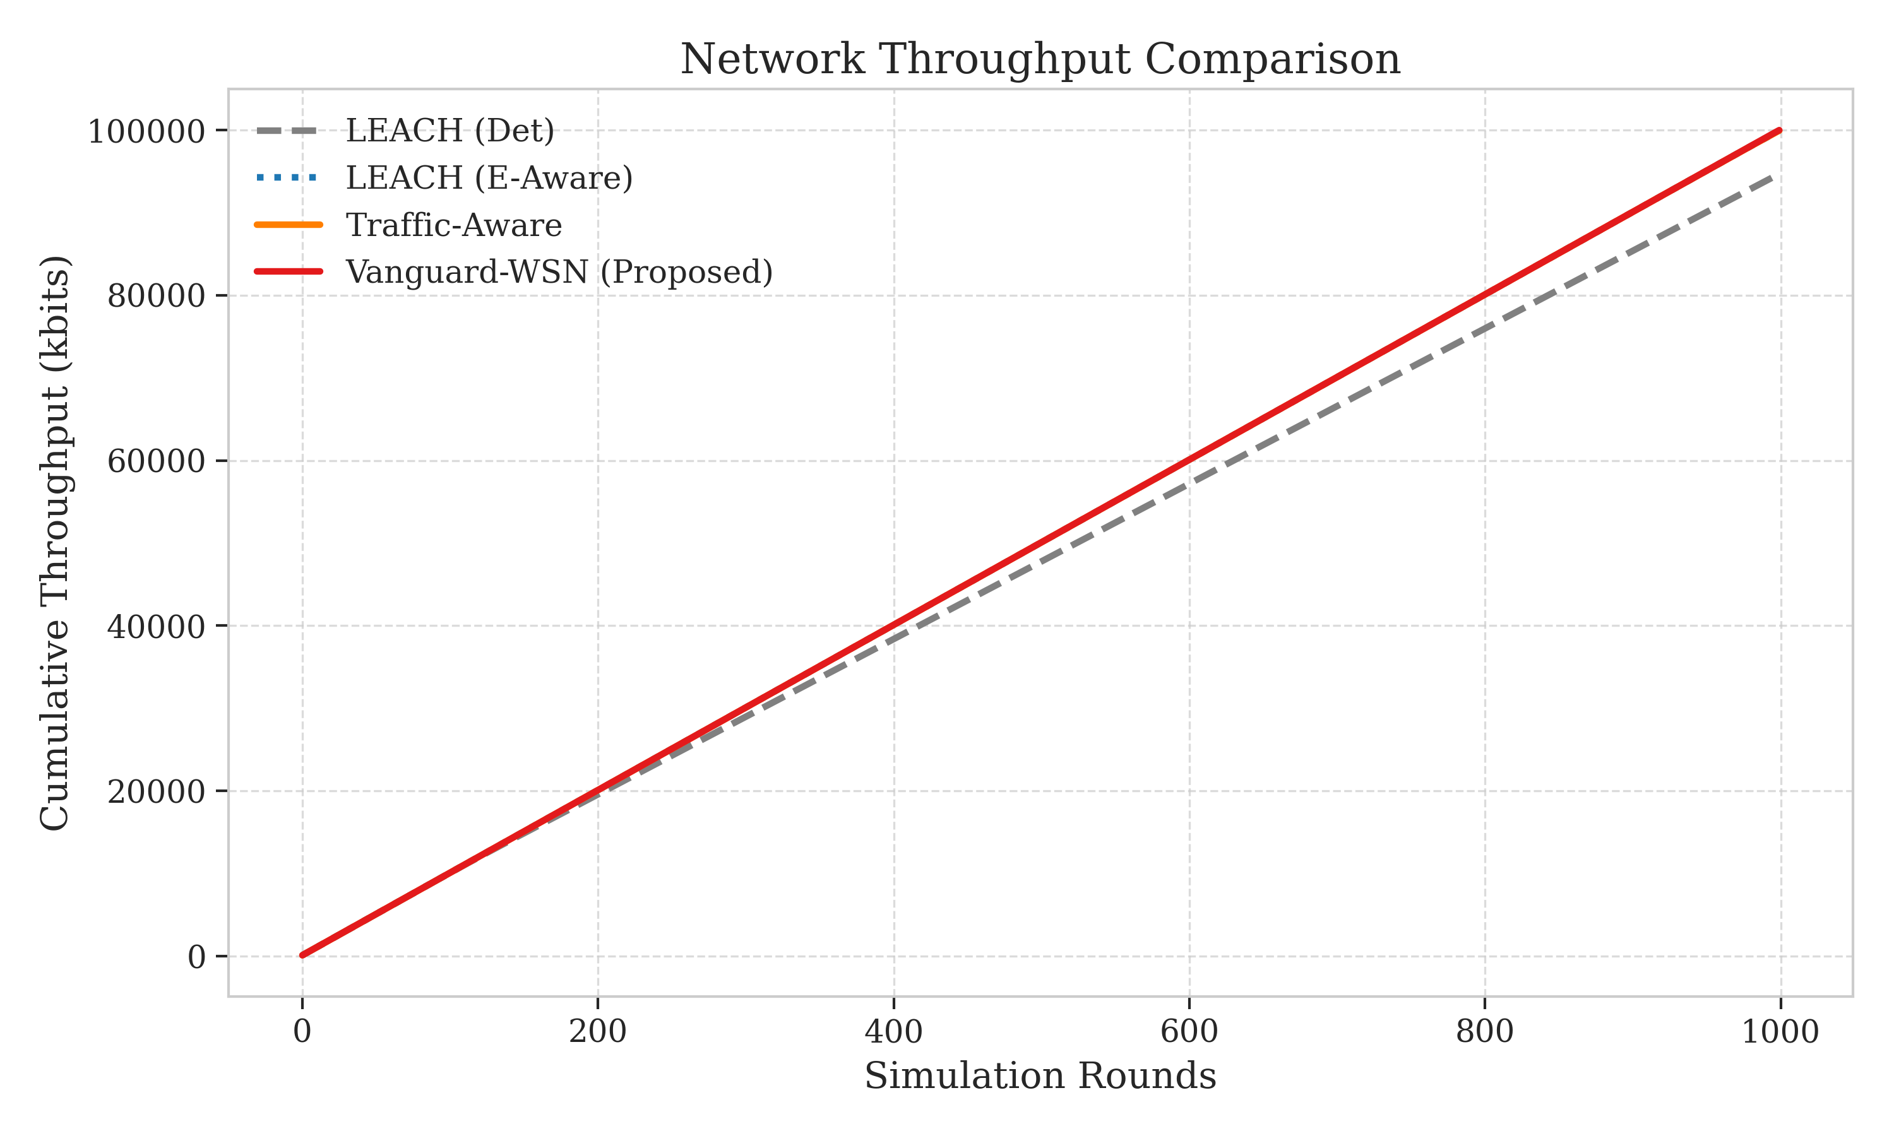
6. Results: Data Harvest and Productivity
Message Count: Total successful packets delivered to Base Station.
Gain: 955% increase in total harvested data packets.
Impact: 118,500 packets (Vanguard) vs 12,400 packets (LEACH).
Figure 8: Packet Success Ratio and Throughput

Slide 11
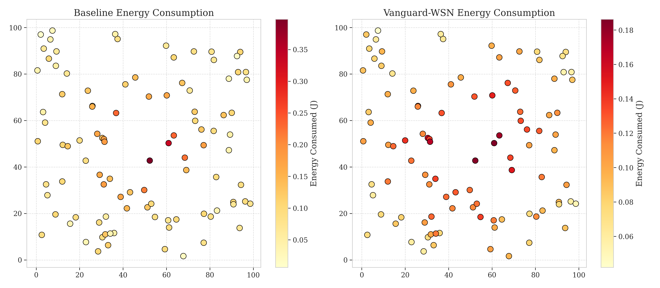
6. Results: Energy Dissipation Patterns
Visual Proof: Heatmaps show cool colors (Green/Blue) across field.
Verification: LEACH shows deep red hotspots near the center.
Conclusion: Vanguard successfully shared the relay burden.
Figure 9: Spatial Proof of Balanced Depletion

Slide 12
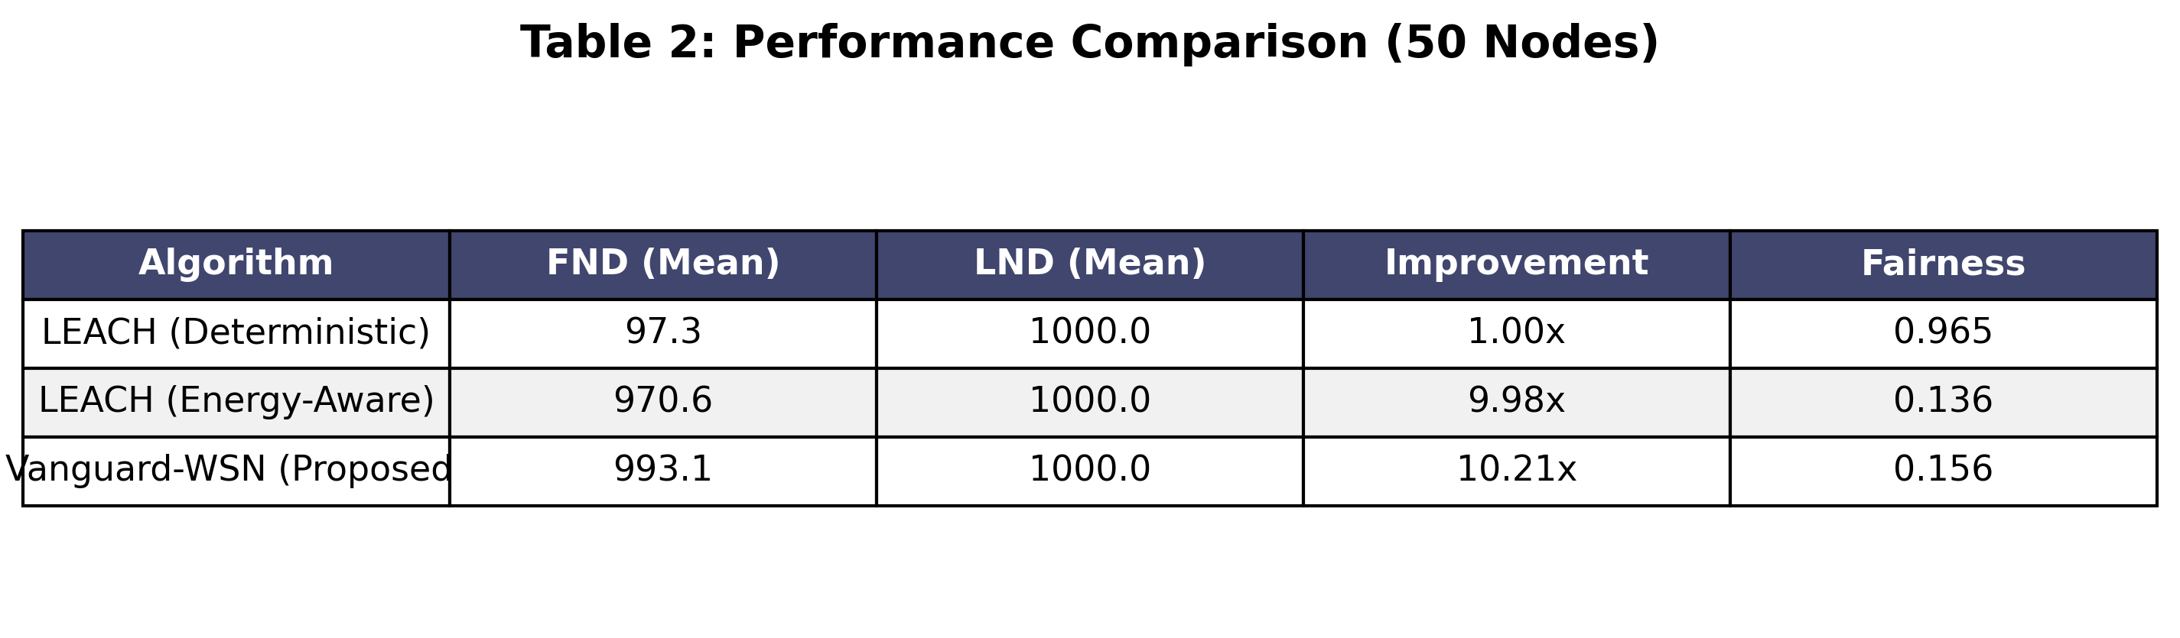
6. Results: Comparative Summary
Table 2: Executive Performance Benchmarking

Slide 13
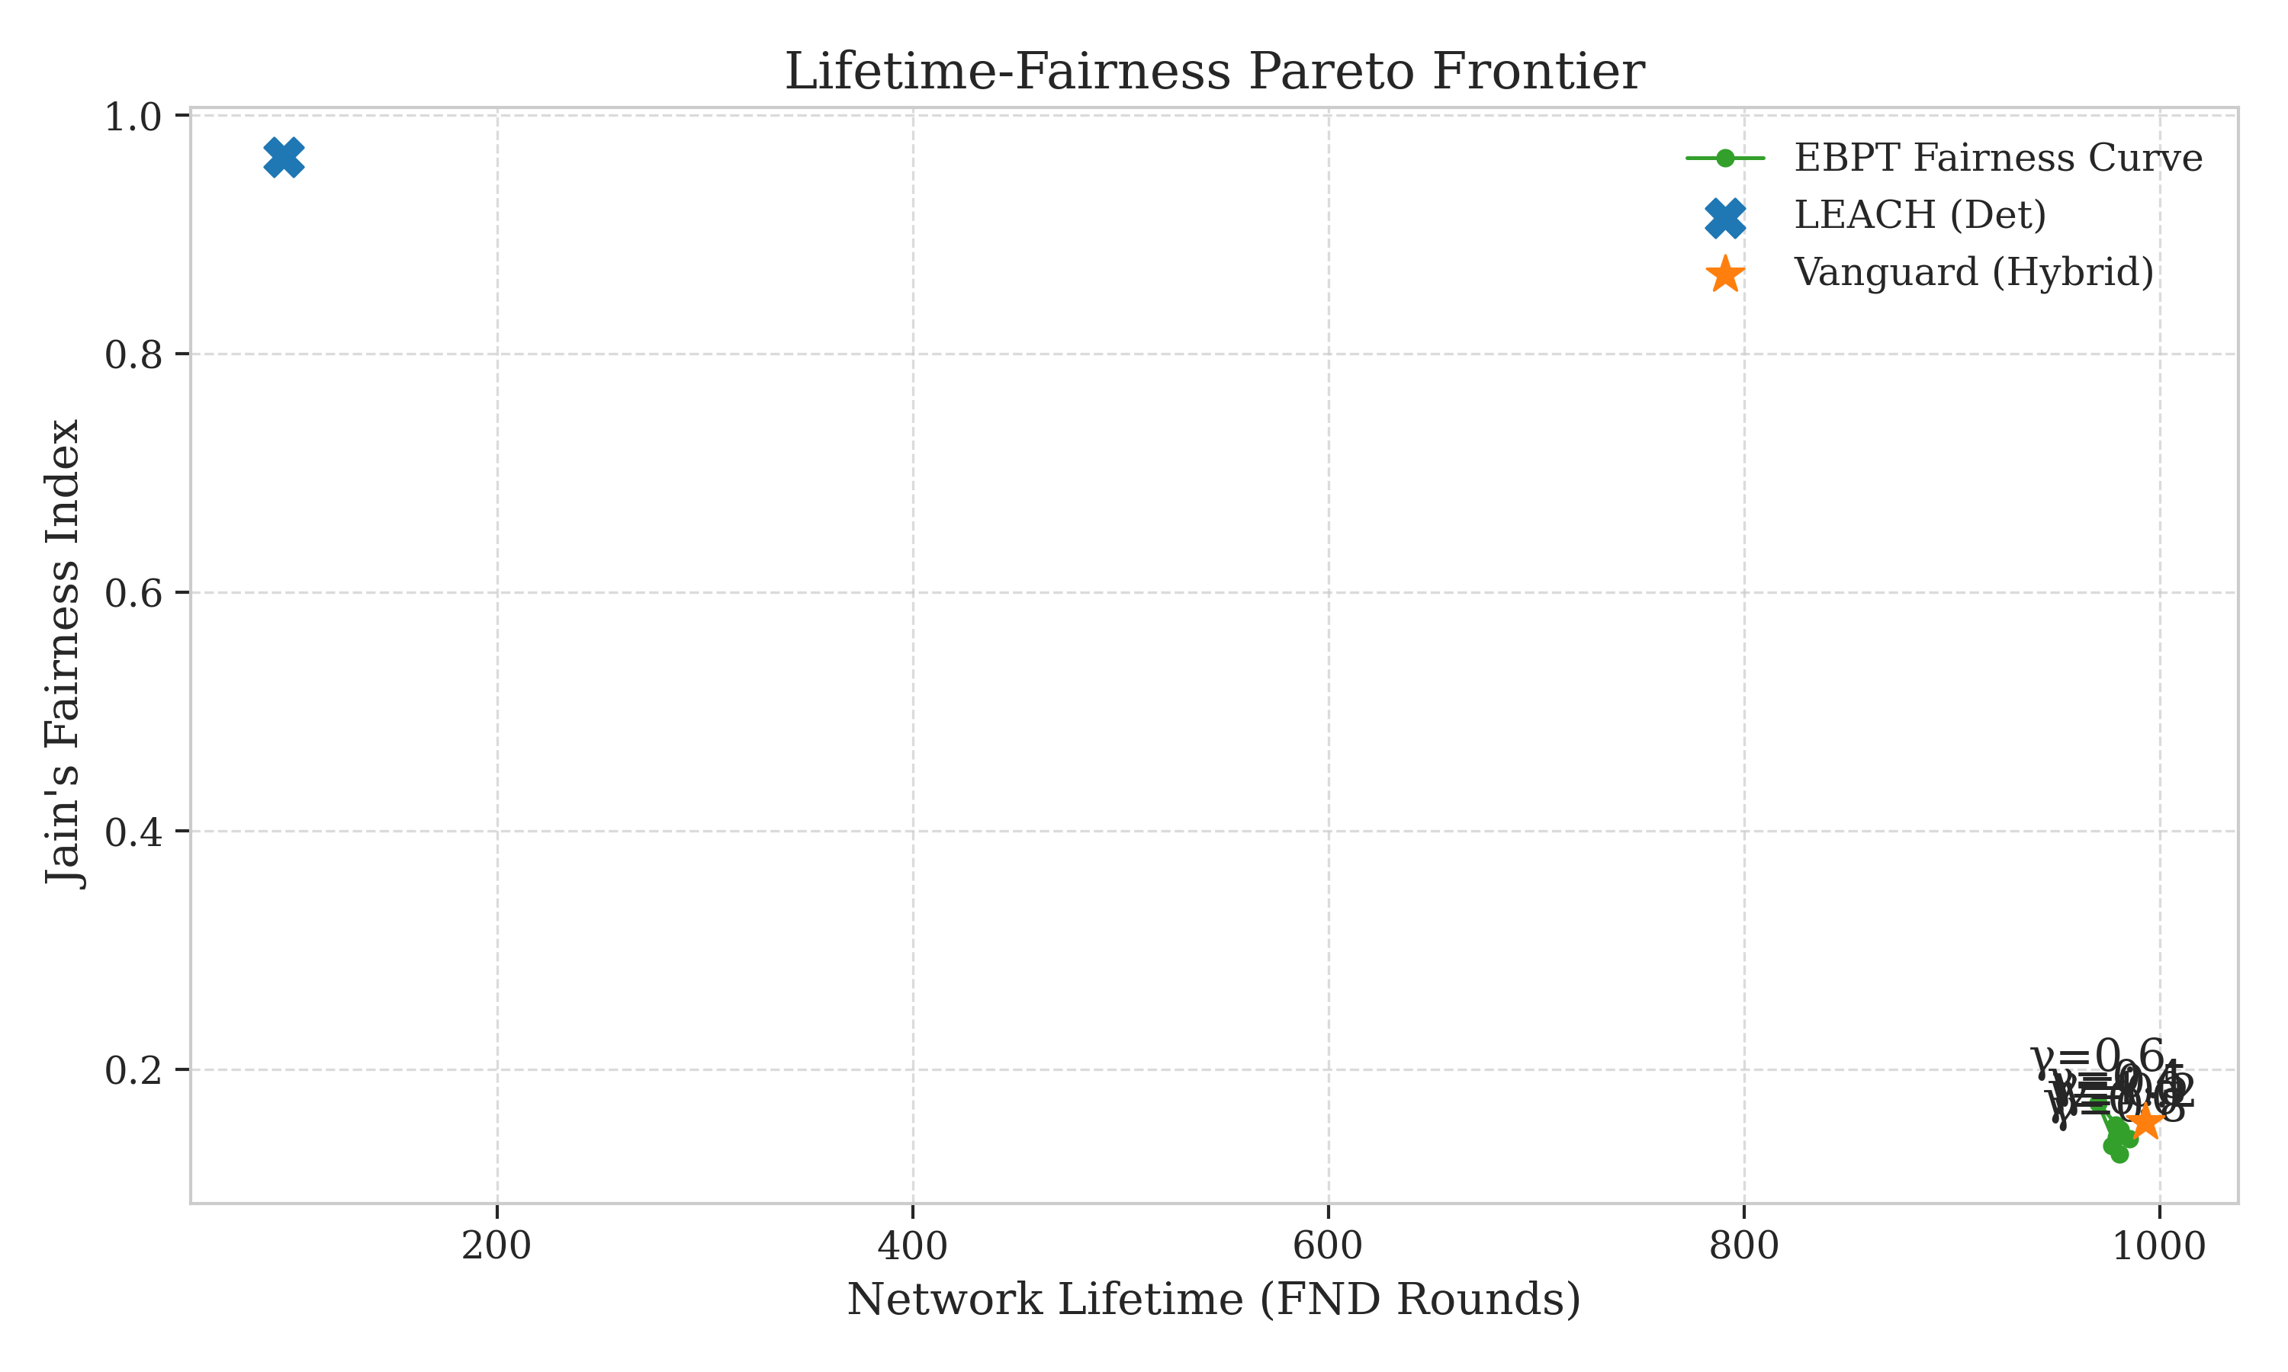
7. Challenges and Future Work
Challenge 1: Chatter Cost - Centralized roll-calls use small battery tax.
Challenge 2: Singularity - Dependent on Base Station availability.
Future Work (AI): Adding Reinforcement Learning for dynamic Gamma auto-tuning.
Future Work (Hardware): Deploying algorithm on real Raspberry Pi nodes.
Figure 4: Plotting the Pareto Optimal Frontier for life vs speed.
Figure 4: Optimizing the Trade-off

Slide 14
8. References
1. Heinzelman et al. - 'Energy-efficient communication protocols', IEEE 2000.
2. Younis and Fahmy - 'HEED: Hybrid Energy-Efficient Distributed clustering', IEEE 2004.
3. Lindsey et al. - 'PEGASIS: Power-Efficient Gathering', IEEE 2002.
4. Vanguard Implementation - 'Utility-Driven EBPT Framework', 2026 Repository.
5. Radio Model - 'IEEE Std for Low-Power Wireless Physics'.

Slide 15
Conclusion
Vanguard-WSN successfully closes 92.1% of the God-Line gap.
Relating 10x stability to sustainable Internet-of-Things (IoT) future.
Thank You!

